Slide 1
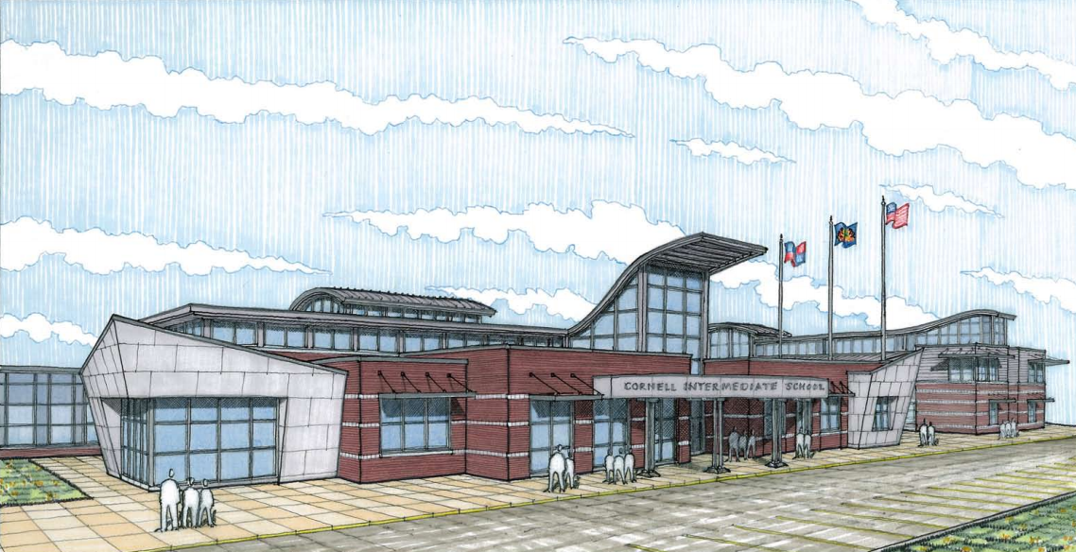
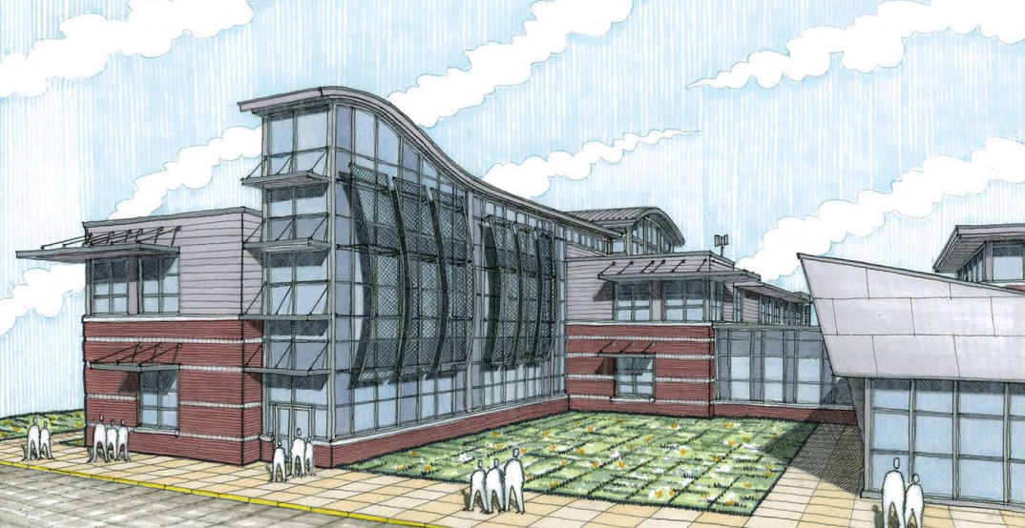
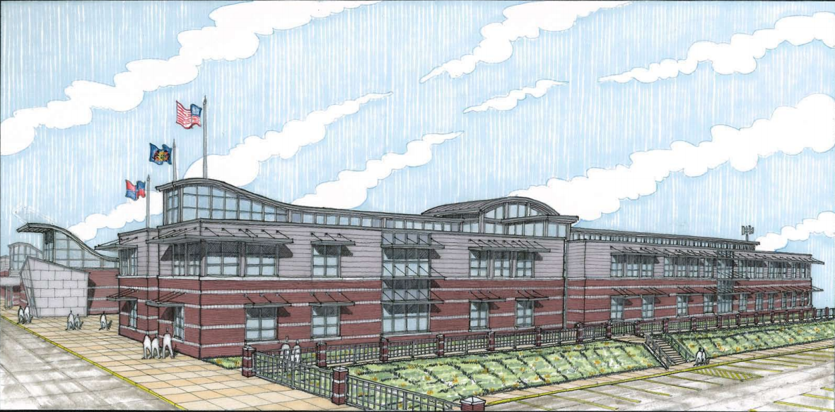
Twin Rivers Elementary/Intermediate School
McKeesport, PA
PENN STATE AE SENIOR CAPSTONE PROJECT
CHERRY Q. LU | CONSTRUCTION OPTION
ADVISOR: RAY SOWERS

Slide 2
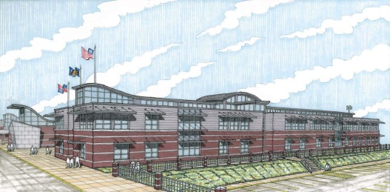
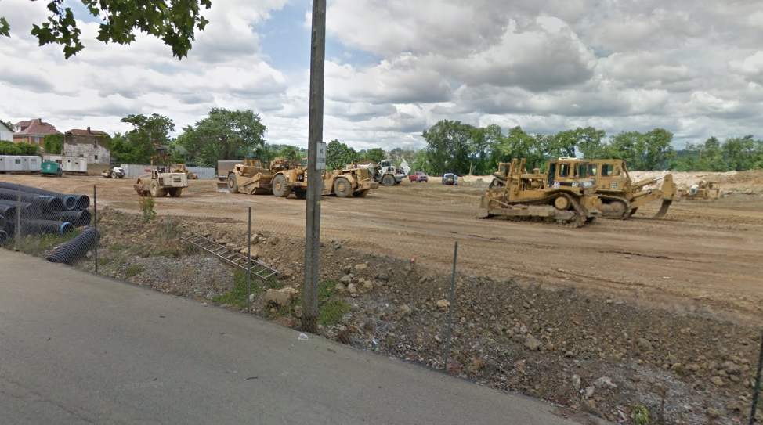
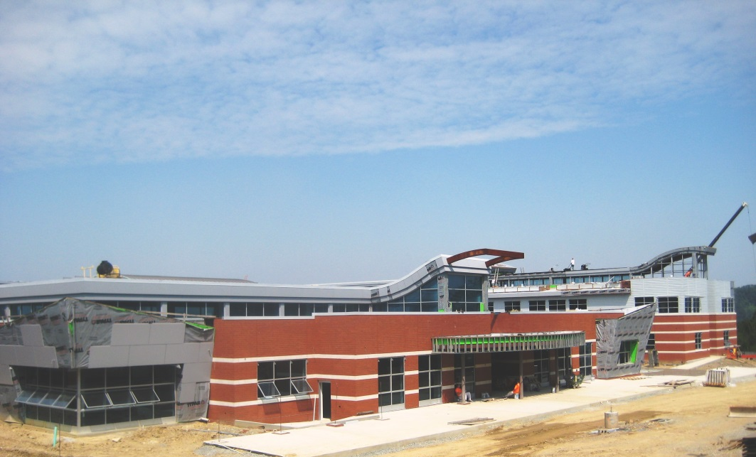
Twin Rivers Elementary/
Intermediate School
McKeesport, PA
CHERRY Q. LU | CONSTRUCTION OPTION
PROJECT BACKGROUND
PRESENTATION OUTLINE:
Project Introduction
Analysis 1: LEED Implementation
Problem Identification
Case Studies
Results
Analysis 2: Value Engineering
Problem Identification
Case Studies
Results: Cost Analysis
Electrical Breadth
Structural Breadth
Analysis 3: Schedule Acceleration
Problem Identifications
Results
Analysis 4: BIM Implementation
Problem Identification
Case Studies
Results
Conclusion
Acknowledgements
Appendices
Project Team
Project Background
Location: 1600 Cornell St, McKeesport, PA‎
Occupancy: Educational
Total Levels: 3 stories
Size: 127,000 GSF
Dates of Construction: February 2013-January 2014
Building Cost: $28 million
Project Delivery Method: Design-Bid-Build
Owner: McKeesport Area School District
Architect: JC Pierce LLC.
Construction Manager: PJ Dick, Inc.
General Contractor: Gurtner Construction
Civil Engineers: Phillips & Associates, Inc.
Structural & MEP Engineers: Loftus Engineers
Environmental Engineers: American Geosciences, Inc.
LEED Feature
SITE BEFORE CONSTRUCTION
Geothermal System
Grey Water Capture System
Solar Shading
Day Lighting
Wind Turbines
SITE DURING CONSTRUCTION

Slide 3
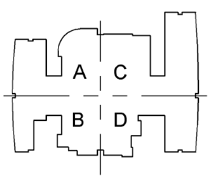
Twin Rivers Elementary/
Intermediate School
McKeesport, PA
CHERRY Q. LU | CONSTRUCTION OPTION
PROJECT BACKGROUND
PRESENTATION OUTLINE:
Project Introduction
Analysis 1: LEED Implementation
Problem Identification
Case Studies
Results
Analysis 2: Value Engineering
Problem Identification
Case Studies
Results: Cost Analysis
Electrical Breadth
Structural Breadth
Analysis 3: Schedule Acceleration
Problem Identifications
Results
Analysis 4: BIM Implementation
Problem Identification
Case Studies
Results
Conclusion
Acknowledgements
Appendices
Electrical System
Schedule
Project Feature
Schedule Breakdown
Phase | Start Date | End Date | Duration
Project Planning Phase | 3/24/2009 | 12/9/2009 | 260
Schematic Design Phase | 12/9/2009 | 6/1/2010 | 139
Design Development Phase | 3/1/2010 | 9/6/2010 | 144
Construction Documents Phase | 4/23/2010 | 5/5/2011 | 270
Bidding Phase | 5/25/2010 | 8/225/11 | 328
Construction Administration Phase | 7/8/2010 | 3/24/2014 | 968
Construction Phase | 5/3/2012 | 12/13/2013 | 648
Substantial Completion | 12/13/2013 | 12/13/2013 | 1
Project Close-out | 13/13/2013 | 3/24/2014 | 110
Supply: 480/277 V from supply with 208/120 step-down transformer
Lighting: Fluorescent with LED, HID, incandescent
Controls: Astronomical timer control for exterior; occupancy sensors for interior
Weather impact cause change orders
Multiple LEED systems
Long close out time
Long interior fit-out time
Long planning phase (hearings)
Wide spread work sequence for MEP
Structural System
Cost
Project Financial Data
Construction Cost | $23,450,000 | Total Cost | $ 28,084,000.00
Construction Cost/Sq Ft | $184.65 | Total Cost/Sq Ft | $ 221.13
Foundation: 4” Spread footing shallow foundation
Superstructure: Structural steel with concrete slab
Roofing System: Composed structural steel system with metal decking.
Major Building System Cost
Trade | Value | Value/Sq Ft
Concrete | $7,035,000.0 | $55.39
Earthwork | $2,814,000.00 | $22.16
Electrical | $4,924,500.00 | $38.78
Mechanical & Plumbing | $3,986,500.00 | $31.39
Equipments | $2,814,000.00 | $22.16
Others | $1,876,000.00 | $14.77
CONSTRUCTION SEQUENCING DIAGRAM

Slide 4
Twin Rivers Elementary/
Intermediate School
McKeesport, PA
CHERRY Q. LU | CONSTRUCTION OPTION
Analysis I: LEED Implementation
PRESENTATION OUTLINE:
Project Introduction
Analysis 1: LEED Implementation
Problem Identification
Case Studies
Results
Analysis 2: Value Engineering
Problem Identification
Case Studies
Results: Cost Analysis
Electrical Breadth
Structural Breadth
Analysis 3: Schedule Acceleration
Problem Identifications
Results
Analysis 4: BIM Implementation
Problem Identification
Case Studies
Results
Conclusion
Acknowledgements
Appendices
Goal of Analysis I
Owner’s Goal:
District Scientific Education Center
State-of-the-Art Facility
Current Design:
Renewable Energy Only for Showcase Purpose
Area of Study:
Possibility of Renewable Energy Production for self-usage
LEED Improvement from the update
LEED in Public School
Potential Design | Points Earned | Points Missed
Sustainable Sites | 19 | 5
Water Efficiency | 9 | 2
Energy and Atmosphere | 25 | 13
Material and Resources | 8 | 5
Indoor Environmental Quality | 16 | 3
Innovation and Design Process | 3 | 3
Regional Priority | 2 | 2
Total Points | 82
Current Design | Points Earned | Points Missed
Sustainable Sites | 19 | 5
Water Efficiency | 9 | 2
Energy and Atmosphere | 10 | 23
Material and Resources | 8 | 5
Indoor Environmental Quality | 16 | 3
Innovation and Design Process | 2 | 4
Regional Priority | 2 | 2
Total Points | 66

Slide 5
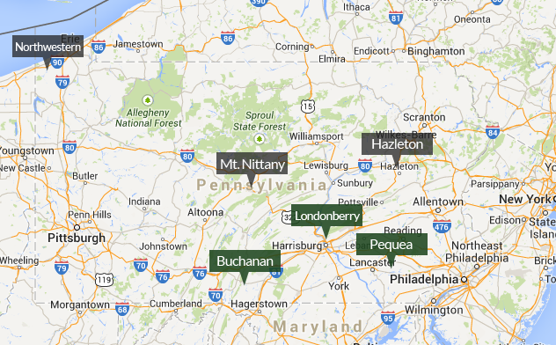
Twin Rivers Elementary/
Intermediate School
McKeesport, PA
CHERRY Q. LU | CONSTRUCTION OPTION
Analysis I: LEED Implementation
PRESENTATION OUTLINE:
Project Introduction
Analysis 1: LEED Implementation
Problem Identification
Case Studies
Results
Analysis 2: Value Engineering
Problem Identification
Case Studies
Results: Cost Analysis
Electrical Breadth
Structural Breadth
Analysis 3: Schedule Acceleration
Problem Identifications
Results
Analysis 4: BIM Implementation
Problem Identification
Case Studies
Results
Conclusion
Acknowledgements
Appendices
Research Result I:
Penn State University is Home to:
Pennsylvania Wind for School Project(WFSP)
Wind Application Center (WAC) for Pennsylvania
Purpose:
Help host schools seek funding.
Technical consults.
Goals:
Work with selected schools to raise funding for and install small wind turbine (<2kw)
Students and Faculty assist in assessment, design and installation of wind system.
Provide teacher training and hands-on curricula for interactive and interschool wind-related activities.
Supported by:
The Wind Powering America Program
The National Renewable Energy Laboratory (NREL)
Department of Energy’s (DOE’s) Energy Efficiency and Renewable Energy Office
The National Wind for Schools program
MAP OF CURRENT HOST SCHOOLS FOR WFS PROGRAM

Slide 6
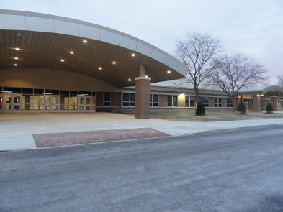
Twin Rivers Elementary/
Intermediate School
McKeesport, PA
CHERRY Q. LU | CONSTRUCTION OPTION
Analysis I: LEED Implementation
PRESENTATION OUTLINE:
Project Introduction
Analysis 1: LEED Implementation
Problem Identification
Case Studies
Results
Analysis 2: Value Engineering
Problem Identification
Case Studies
Results: Cost Analysis
Electrical Breadth
Structural Breadth
Analysis 3: Schedule Acceleration
Problem Identifications
Results
Analysis 4: BIM Implementation
Problem Identification
Case Studies
Results
Conclusion
Acknowledgements
Appendices
Case Study I:
Boyce Middle School
Uniqueness:
School Board is the driving force of LEED
Established a LEED study committee
A vehicle for local business and professional leaders to lend their expertise toward school construction.
Similarities:
LEED Certified Public Middle School
Located in Allegheny County
Hearing and decision process for LEED
Lessons Learned:
School Board initiative
Financial benefit from industry donors
Message sent to the students and the community about social responsibility, science and the benefits of quality learning environment.
Role-Model for Twin Rivers Project
BOYCE MIDDLE SCHOOL

Slide 7
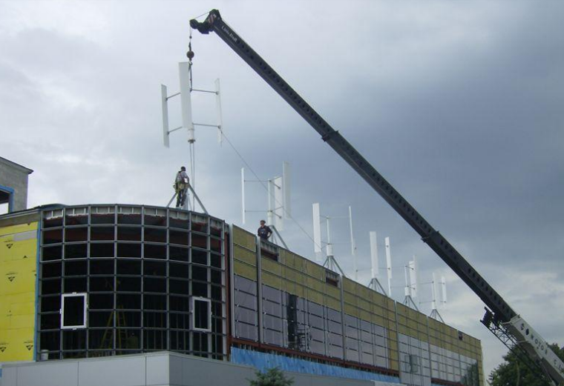
Twin Rivers Elementary/
Intermediate School
McKeesport, PA
CHERRY Q. LU | CONSTRUCTION OPTION
Analysis I: LEED Implementation
PRESENTATION OUTLINE:
Project Introduction
Analysis 1: LEED Implementation
Problem Identification
Case Studies
Results
Analysis 2: Value Engineering
Problem Identification
Case Studies
Results: Cost Analysis
Electrical Breadth
Structural Breadth
Analysis 3: Schedule Acceleration
Problem Identifications
Results
Analysis 4: BIM Implementation
Problem Identification
Case Studies
Results
Conclusion
Acknowledgements
Appendices
Case Study II:
Mount Nittany Elementary/Intermediate School
Uniqueness:
Participant of Penn WFS Project
Received funding of $ 16,000 (= $ 5,000 from West Penn Power Sustainable Energy Fund(WPPSEF) + $5,000 from Lowes Educational Toolbox + $5,000 from Citizen Power + $ 1,000 from the Superintendent’s Fund for Instruction Innovation)
Education program with support from Penn State University
Similarities:
LEED Certified Public School
Two schools in one campus
Hearing and decision process for LEED
Lessons Learned:
Early planning
Financial assistance from WFS Project
Education curricula from both schools
INSTALLATION OF ROOF-TOP TURBINES

Slide 8
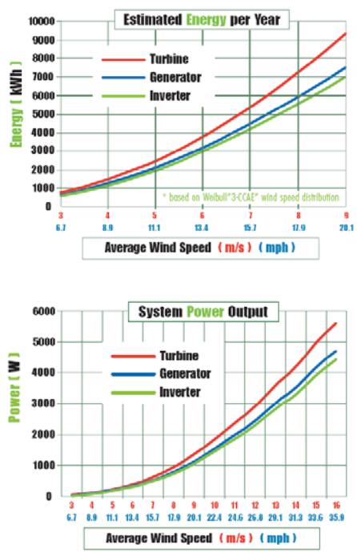
Twin Rivers Elementary/
Intermediate School
McKeesport, PA
CHERRY Q. LU | CONSTRUCTION OPTION
Analysis I: LEED Implementation
PRESENTATION OUTLINE:
Project Introduction
Analysis 1: LEED Implementation
Problem Identification
Case Studies
Results
Analysis 2: Value Engineering
Problem Identification
Case Studies
Results: Cost Analysis
Electrical Breadth
Structural Breadth
Analysis 3: Schedule Acceleration
Problem Identifications
Results
Analysis 4: BIM Implementation
Problem Identification
Case Studies
Results
Conclusion
Acknowledgements
Appendices
Rated Power | 600 w
Maximum Output Power | 800 w
Output Voltage | 48 V
Rotor Height | 1.6 m (5.2 ft)
Rotor Diameter | 1.2 m (3.9 ft)
Start-up Wind Speed | 1.5 m/s (3.4 mph)
Rated Wind Speed | 10 m/s (22.3 mph)
Survival Wind Speed | 50 m/s (111.5 mph)
Generator | Permanent Magnetic Generator
Generator Efficiency | >0.96
Turbine Weight | 18 kg (39.6lbs)
Noise | <45dB(A)
Temperature Range | -20°C to +50°C
Design Lifetime | 20 Years
Warranty | Standard 5 Years
Roof-Top Wind Turbine for Energy Production
is Recommended.
Current Turbine:
Showcase purpose only
Vertical axis turbines from Clean Field Energy
Propose Turbine:
Small unit vertical axis turbines from Clean Field Energy
Energy production purpose
ENERGY & POWER OUTPUT

Slide 9
Twin Rivers Elementary/
Intermediate School
McKeesport, PA
CHERRY Q. LU | CONSTRUCTION OPTION
Analysis I: LEED Implementation
PRESENTATION OUTLINE:
Project Introduction
Analysis 1: LEED Implementation
Problem Identification
Case Studies
Results
Analysis 2: Value Engineering
Problem Identification
Case Studies
Results: Cost Analysis
Electrical Breadth
Structural Breadth
Analysis 3: Schedule Acceleration
Problem Identifications
Results
Analysis 4: BIM Implementation
Problem Identification
Case Studies
Results
Conclusion
Acknowledgements
Appendices
Cost Analysis without Funding
The total energy production estimation =
number of units * maximum production of each unit * operation time * system capacity
Assumptions
One unit every 4 square feet
The impact of the installation to the structural system will be analyzed as the structural breadth.
The capacity of a unit from Clean Field is = 23% of its maximum output.
Electricity prices = 0.05 $/Kwh ( based on conservative estimate)
Crane cost = $750 per day + $200 per hour
Thus, 18* 800w * 8766hr * 23% = 29033 Kwh
$ 0.05 * 29033 = $ 1452
Cost saving of $1452/year from the installation of rooftop wind turbine units.

Slide 10
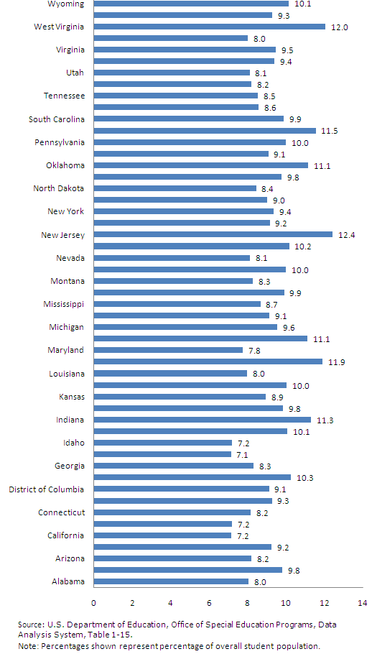
Twin Rivers Elementary/
Intermediate School
McKeesport, PA
CHERRY Q. LU | CONSTRUCTION OPTION
Analysis I: LEED Implementation
PRESENTATION OUTLINE:
Project Introduction
Analysis 1: LEED Implementation
Problem Identification
Case Studies
Results
Analysis 2: Value Engineering
Problem Identification
Case Studies
Results: Cost Analysis
Electrical Breadth
Structural Breadth
Analysis 3: Schedule Acceleration
Problem Identifications
Results
Analysis 4: BIM Implementation
Problem Identification
Case Studies
Results
Conclusion
Acknowledgements
Appendices
LEED in Public School
Factors considered for LEED incentives:
Aged 6-21 population of each state
GDP of each state
Responsibilities of Construction Management Team:
Support LEED projects for long term saving on operation and maintenance cost; short payback period.
Raise the awareness of the benefits of LEED implementation to public schools
Help engage industry donor to assistant with the development of LEED
AGED 6-21 POPULATION PERCENTAGE IN EA. STATE

Slide 11
Twin Rivers Elementary/
Intermediate School
McKeesport, PA
CHERRY Q. LU | CONSTRUCTION OPTION
Analysis II: Value Engineering
PRESENTATION OUTLINE:
Project Introduction
Analysis 1: LEED Implementation
Problem Identification
Case Studies
Results
Analysis 2: Value Engineering
Problem Identification
Case Studies
Results: Cost Analysis
Electrical Breadth
Structural Breadth
Analysis 3: Schedule Acceleration
Problem Identifications
Results
Analysis 4: BIM Implementation
Problem Identification
Case Studies
Results
Conclusion
Acknowledgements
Appendices
Goal of Analysis II
Cost Analysis without Funding
Additional Cost of Roof-Top Wind Turbine System
Item | Unit Cost | Quantity | Cost
Material | 800 | 18 | 14400
Labor | 30 | 18 | 540
Equipment (Crane) | 283 | 9 | 2550
Increase project value by:
Possibility of upsizing electrical distribution system
Implementation of Wind energy production
Assumptions
One unit every 4 square feet
The impact of the installation to the structural system will be analyzed as the structural breadth.
The capacity of a unit from Clean Field is = 23% of its maximum output.
Electricity prices = 0.05 $/Kwh ( based on conservative estimate)
Crane cost = $750 per day + $200 per hour
Total cost from the calculation in table above = $17490
Total cost / cost saving per year = the payback period of the system = 12 years.
12 yrs / 20 yrs = 60%
This is 60% of the system’s designed lifetime.

Slide 12
Twin Rivers Elementary/
Intermediate School
McKeesport, PA
CHERRY Q. LU | CONSTRUCTION OPTION
Analysis II: Value Engineering
PRESENTATION OUTLINE:
Project Introduction
Analysis 1: LEED Implementation
Problem Identification
Case Studies
Results
Analysis 2: Value Engineering
Problem Identification
Case Studies
Results: Cost Analysis
Electrical Breadth
Structural Breadth
Analysis 3: Schedule Acceleration
Problem Identifications
Results
Analysis 4: BIM Implementation
Problem Identification
Case Studies
Results
Conclusion
Acknowledgements
Appendices
R-T Turbine Cost Analysis with Funding
Additional Cost of Roof-Top Wind Turbine System
Item | Unit Cost | Quantity | Cost
Material | 800 | 18 | 14400
Labor | 30 | 18 | 540
Equipment (Crane) | 283 | 9 | 2550
Conservative Estimate of Funding/Grants:
Estimate funding of $ 15,000 = $ 5,000 from West Penn Power Sustainable Energy Fund(WPPSEF) + $5,000 from Lowes Educational Toolbox + $5,000 from Citizen Power
Assumptions
One unit every 4 square feet
The impact of the installation to the structural system will be analyzed as the structural breadth.
The capacity of a unit from Clean Field is = 23% of its maximum output.
Electricity prices = 0.05 $/Kwh ( based on conservative estimate)
Crane cost = $750 per day + $200 per hour
Total cost / cost saving per year = the payback period of the system = 12 years.
2 yrs / 20 yrs = 10%
This is 10% of the system’s designed lifetime.
Total cost = $17490 - $ 15000 = $ 2, 490
The addition of roof-top wind turbine system is cost effective and
Serves the goal of value engineering by improving system value with reasonable cost addition.

Slide 13
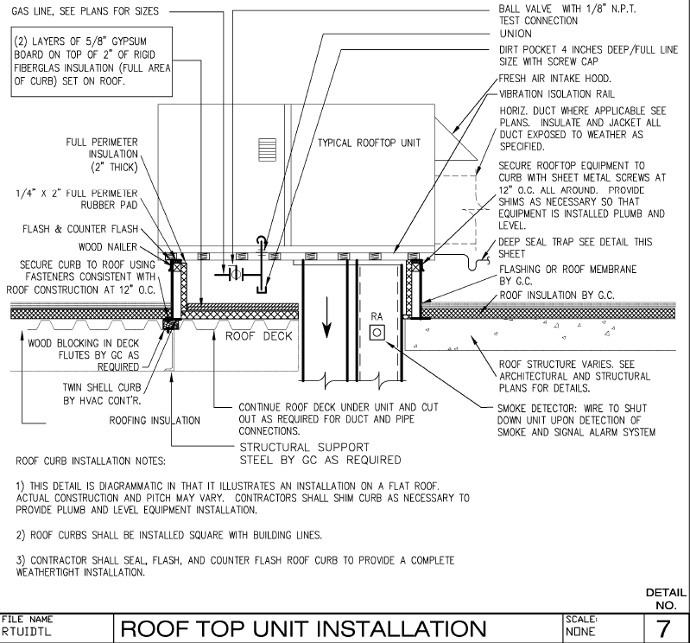
Twin Rivers Elementary/
Intermediate School
McKeesport, PA
CHERRY Q. LU | CONSTRUCTION OPTION
Structural Breadth
PRESENTATION OUTLINE:
Project Introduction
Analysis 1: LEED Implementation
Problem Identification
Case Studies
Results
Analysis 2: Value Engineering
Problem Identification
Case Studies
Results: Cost Analysis
Electrical Breadth
Structural Breadth
Analysis 3: Schedule Acceleration
Problem Identifications
Results
Analysis 4: BIM Implementation
Problem Identification
Case Studies
Results
Conclusion
Acknowledgements
Appendices
W= 1.2 (D_{L})= 1.2*40 = 48 lbs
48 lbs/(4’*4’) = 3 PSF
Dead Load from Roof Top Mechanical Units and Wind Turbine Units
20 + 3 = 23 PSF
Project Team
Assumptions
One unit every 4 square feet
Each unit = 40 lbs
Wind turbines will be sitting on the existing design of roof curb.
Same installation method as roof top mechanical units.
Live & Dead Load on Roof
Item | Load (PSF)
8" Normal Weight Concrete(144 PCF) | 96
Mechanical Units Including Roof-Top Turbine Units | 23
Build-Up Roofing System | 20
Total Dead Load | 139
Roof Live Load | 20
Total Live Load | 20
CURRENT DESIGN OF ROOF TOP MECHANICAL UNIT INSTALLATION

Slide 14
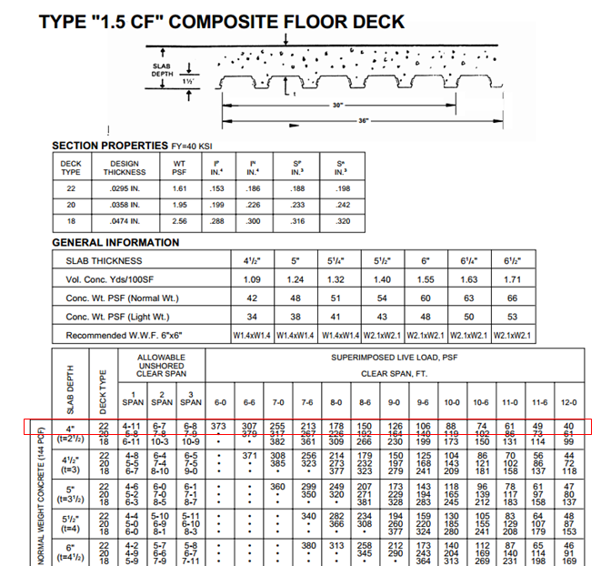
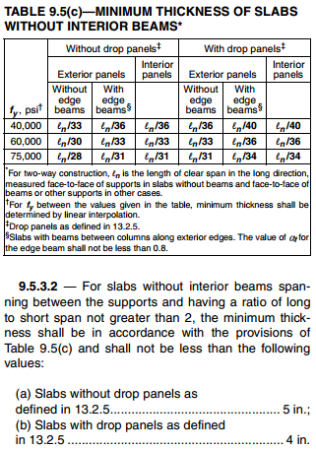
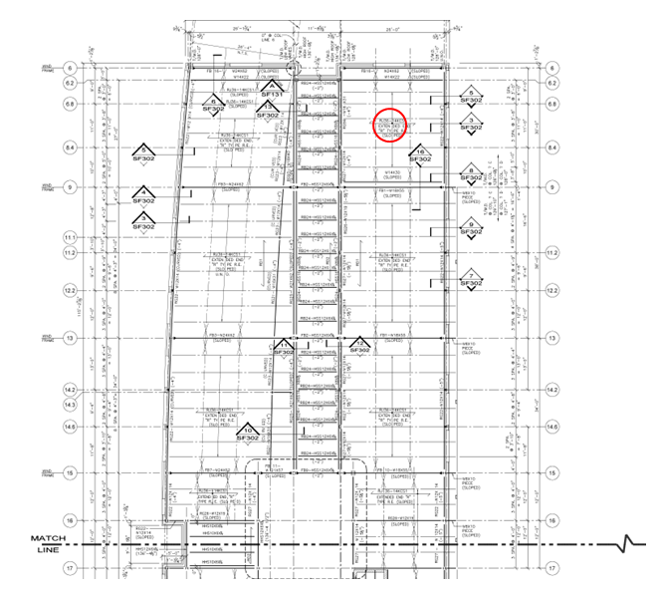
Twin Rivers Elementary/
Intermediate School
McKeesport, PA
CHERRY Q. LU | CONSTRUCTION OPTION
Structural Breadth
PRESENTATION OUTLINE:
Project Introduction
Analysis 1: LEED Implementation
Problem Identification
Case Studies
Results
Analysis 2: Value Engineering
Problem Identification
Case Studies
Results: Cost Analysis
Electrical Breadth
Structural Breadth
Analysis 3: Schedule Acceleration
Problem Identifications
Results
Analysis 4: BIM Implementation
Problem Identification
Case Studies
Results
Conclusion
Acknowledgements
Appendices
Factored Distributed Load: W = (1.2)(DL) + (1.6)(LR)
Wu = (1.2)(139 PSF) + (1.6)(20 PSF) = 198.8 PSF
Deflection (ACI 318-11): Ln/33<Thickness of slab
20’(12”/1’)/33 <8” = 7.2727”<8”
Max Vertical Deflection of Roof Deck: 1/240 of span
1/240*20ft*12 in/ft = 1”< TL/180 = 1.39”
Ultimate Shear
Vu = (312 PSF)(18.60’ x 18.09’) = 64,603 lbs.
Critical Shear Vc = 4λ bod c f '
bo = 2 (24” + 8”) + 2 (21” + 8”) = 122”
d= (8 – 0.75)
Vc = 4(1) (122”)(8-0.75) = 250,174.3792 lbs. psi 5000
Punching Shear
Vu < ɸ Vc
64,603 lbs. < (0.75) x (250,174.38 lbs.)
64,603 lbs. < 187,630.78 lbs
Assumed Typical Bay Calculated in Zone A
Current design meets design criteria.
Structural Concrete Building Code (ACI 318-11)

Slide 15
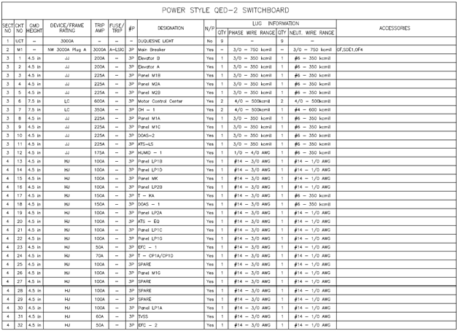
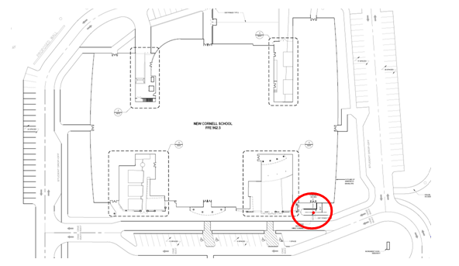
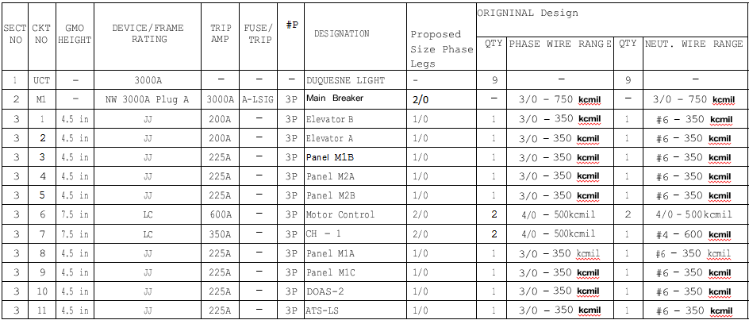
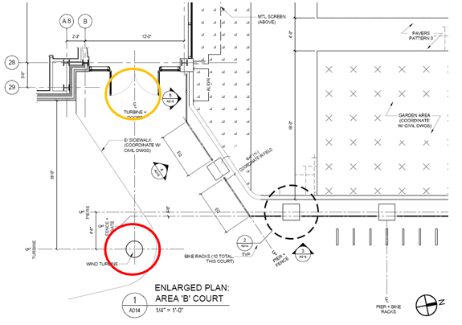
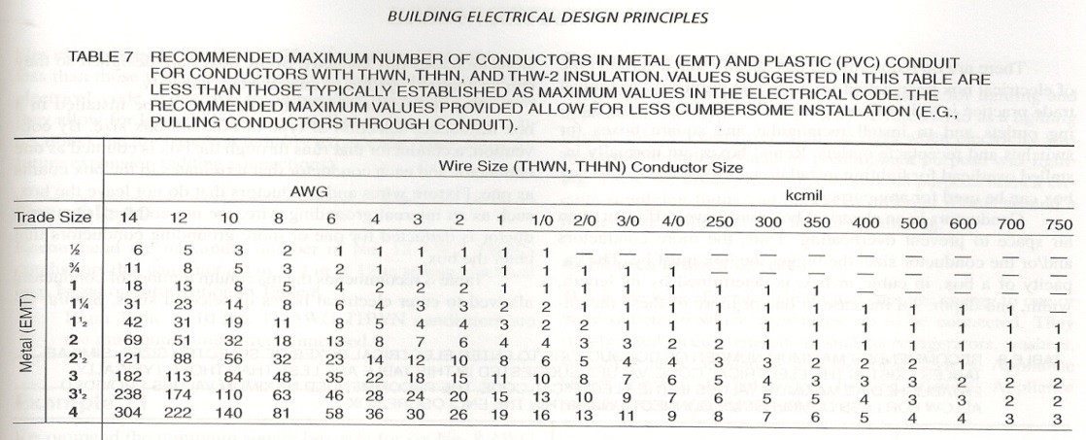
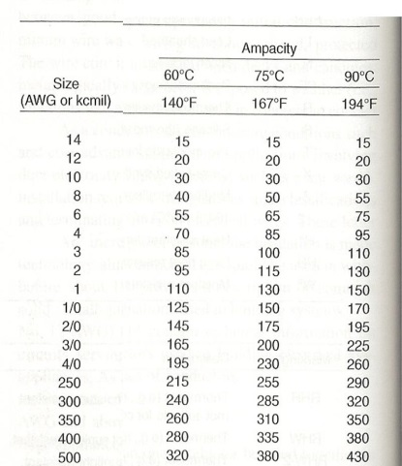
Twin Rivers Elementary/
Intermediate School
McKeesport, PA
CHERRY Q. LU | CONSTRUCTION OPTION
Electrical Breadth
PRESENTATION OUTLINE:
Project Introduction
Analysis 1: LEED Implementation
Problem Identification
Case Studies
Results
Analysis 2: Value Engineering
Problem Identification
Case Studies
Results: Cost Analysis
Electrical Breadth
Structural Breadth
Analysis 3: Schedule Acceleration
Problem Identifications
Results
Analysis 4: BIM Implementation
Problem Identification
Case Studies
Results
Conclusion
Acknowledgements
Appendices
Pole-Mounted Wind Turbine Location
UPSIZED THE DISTRIBUTION SYSTEM
CURRENT SWITCHBOARD SCHEDULE
Pole-Mounted Turbine/Electrical Room
DESIGN PRINCIPLE

Slide 16
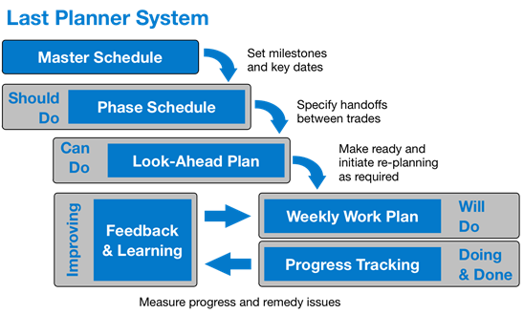
Twin Rivers Elementary/
Intermediate School
McKeesport, PA
CHERRY Q. LU | CONSTRUCTION OPTION
Analysis III: Schedule Acceleration
PRESENTATION OUTLINE:
Project Introduction
Analysis 1: LEED Implementation
Problem Identification
Case Studies
Results
Analysis 2: Value Engineering
Problem Identification
Case Studies
Results: Cost Analysis
Electrical Breadth
Structural Breadth
Analysis 3: Schedule Acceleration
Problem Identifications
Results
Analysis 4: BIM Implementation
Problem Identification
Case Studies
Results
Conclusion
Acknowledgements
Appendices
Goal of Analysis III
Project Features
Tight schedule time frame of 21 months construction for high-performance facility with LEED implementations
Addition of project value per the order of Penn Department of Environmental Protection of $ 156,275 from insufficient sedimentation and erosion control on site
3 weeks of addition of scope
Symmetric building structure provides possibility of implementing SIPS
LEAN construction method might help to recover project schedule
Improve project schedule by:
Methods to control unexpected weather impact
Possibility of implementing SIPS method
Possibility of implementing Last Planner System

Slide 17
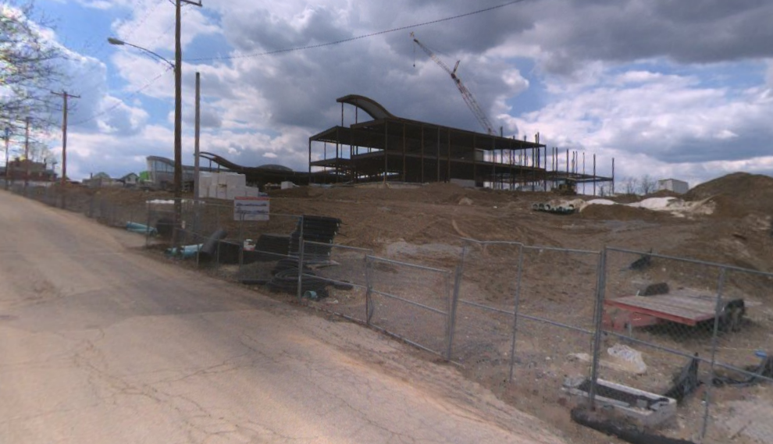
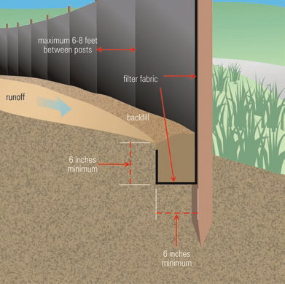
Twin Rivers Elementary/
Intermediate School
McKeesport, PA
CHERRY Q. LU | CONSTRUCTION OPTION
Analysis III: Schedule Acceleration
PRESENTATION OUTLINE:
Project Introduction
Analysis 1: LEED Implementation
Problem Identification
Case Studies
Results
Analysis 2: Value Engineering
Problem Identification
Case Studies
Results: Cost Analysis
Electrical Breadth
Structural Breadth
Analysis 3: Schedule Acceleration
Problem Identifications
Results
Analysis 4: BIM Implementation
Problem Identification
Case Studies
Results
Conclusion
Acknowledgements
Appendices
Scenario I:Precautionary and Reaction Plan
Analysis Components
Cost impact for the proposed system
Schedule impact for the proposed system
Cost and schedule compared with the original system per EPA’s order
Project Features
Urban surrounding
Relative high elevation
Site takes up an entire block
Clear material delivery routes
Estimate Based on
RS Means Green Building Cost Data 2014 (31 25 14.16)
Proposed System
Slope stakes: interval of 4’
Normal silt fence for high elevation than surrounding
SOIL RUN-OFF TO NEIGHBORING ROAD
EPA SILT FENCING DETAIL

Slide 18
Twin Rivers Elementary/
Intermediate School
McKeesport, PA
CHERRY Q. LU | CONSTRUCTION OPTION
Analysis III: Schedule Acceleration
PRESENTATION OUTLINE:
Project Introduction
Analysis 1: LEED Implementation
Problem Identification
Case Studies
Results
Analysis 2: Value Engineering
Problem Identification
Case Studies
Results: Cost Analysis
Electrical Breadth
Structural Breadth
Analysis 3: Schedule Acceleration
Problem Identifications
Results
Analysis 4: BIM Implementation
Problem Identification
Case Studies
Results
Conclusion
Acknowledgements
Appendices
Cost Analysis
Scenario I:Precautionary and Reaction Plan
31 25 14.16 | Stabilization Measures for Erosion and Sedimentation Control
Item | Daily Output | Labor Hrs | Quantity | Unit | Material | Labor | Equip. | Total | Total Include O&P | Total Cost | Total Days
Slope Stakes (3'-5' Interval) | - | - | 739 | Ea. | 0.11 | - | - | 0.11 | 0.12 | 88.63 | -
Silt Fence 3' High | 1600 | 0.01 | 2954 | LF. | 0.24 | 0.37 | - | 0.61 | 0.83 | 2452.09 | 4
Cost Benefits
Cost saving of 98.37% compared with $156,275
87.49% of the cost saving is from the material and labor
Schedule Benefits
Total Durations = 30 hours / 8 hours per day = 3.75 days per crew member (round up to 4 days)
Duration with 4 working crews = Total Durations / 4 crew members = 1 day
95% saving on schedule
SOIL RUN-OFF TO NEIGHBORING ROAD
Total Cost of the Precautionary Plan = $88.63 + $2452.09 = $2540.72
EPA SILT FENCING DETAIL

Slide 19
Twin Rivers Elementary/
Intermediate School
McKeesport, PA
CHERRY Q. LU | CONSTRUCTION OPTION
Analysis III: Schedule Acceleration
PRESENTATION OUTLINE:
Project Introduction
Analysis 1: LEED Implementation
Problem Identification
Case Studies
Results
Analysis 2: Value Engineering
Problem Identification
Case Studies
Results: Cost Analysis
Electrical Breadth
Structural Breadth
Analysis 3: Schedule Acceleration
Problem Identifications
Results
Analysis 4: BIM Implementation
Problem Identification
Case Studies
Results
Conclusion
Acknowledgements
Appendices
Scenario II: SIPS Method
Project Features
Symmetry of building structure
Similar design of two wings
Two-stories above ground
Lack of proactive planning
Rescheduling activities due to weather impacts
Multiple change orders for value engineering or other purposes after start of construction
Delay of project start date due to the extension of decision process and the demolish project prior to the start of construction
Limited learning curve due to weather impact
Extra material staging, equipment moving time due to weather impact
SIPS
A short interval production schedule (SIPS) is based upon repeatable construction activities that can be detailed by tasks and work days and then scheduled sequentially.
Due to the equivalent durations of each activity, a matrix can clearly reflect a direct flow of work from one activity to the next in a typical area.
Fast-tracked projects.
SOIL RUN-OFF TO NEIGHBORING ROAD
Benefit of SIPS implementation is limited.
CONSTRUCTION SEQUENCING DIAGRAM

Slide 20
Twin Rivers Elementary/
Intermediate School
McKeesport, PA
CHERRY Q. LU | CONSTRUCTION OPTION
Analysis III: Schedule Acceleration
PRESENTATION OUTLINE:
Project Introduction
Analysis 1: LEED Implementation
Problem Identification
Case Studies
Results
Analysis 2: Value Engineering
Problem Identification
Case Studies
Results: Cost Analysis
Electrical Breadth
Structural Breadth
Analysis 3: Schedule Acceleration
Problem Identifications
Results
Analysis 4: BIM Implementation
Problem Identification
Case Studies
Results
Conclusion
Acknowledgements
Appendices
Scenario III: Last Planner System
Project Features
Need of a recovery plan from the weather impact
High commitment from the project team after the impact
Weekly meeting on schedule catch up
Adoption of extra crews and extra working time
Last Planner System
A very collaborative planning process developed by the Lean Construction Institute.
A process that works backwards from the project’s turnover date and the last activity in the sequence towards the current time and completion stage.
The most current activity will be defined an activity further downstream in the activity sequence.
Requires very high commitment and promises from the project team, especially the management team.
Method Implementation
New backward inducted project schedule can be developed with updated schedules of each trade.
Phase schedule, look-ahead plans, and weekly work plans can be developed and followed-up.
Implementation of Last Planner Method is highly recommended.

Slide 21
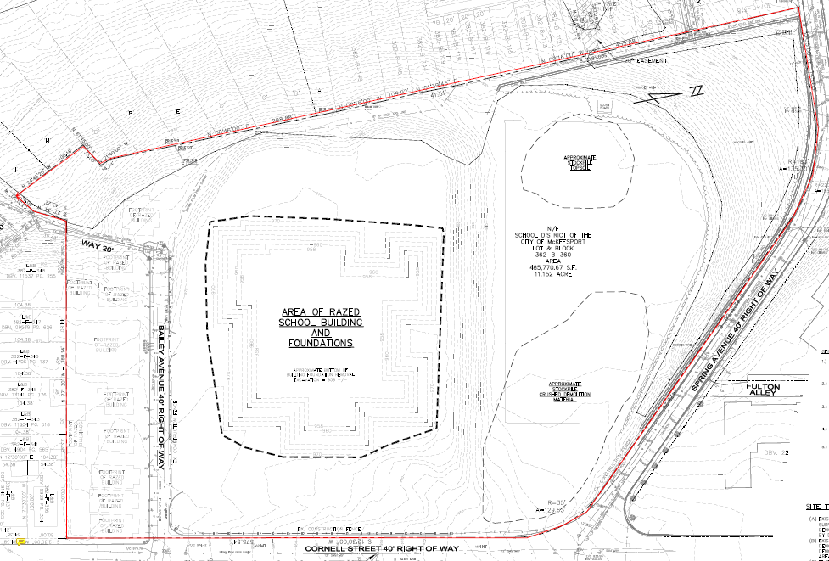
Twin Rivers Elementary/
Intermediate School
McKeesport, PA
CHERRY Q. LU | CONSTRUCTION OPTION
Analysis III: Schedule Acceleration
PRESENTATION OUTLINE:
Project Introduction
Analysis 1: LEED Implementation
Problem Identification
Case Studies
Results
Analysis 2: Value Engineering
Problem Identification
Case Studies
Results: Cost Analysis
Electrical Breadth
Structural Breadth
Analysis 3: Schedule Acceleration
Problem Identifications
Results
Analysis 4: BIM Implementation
Problem Identification
Case Studies
Results
Conclusion
Acknowledgements
Appendices
Summary of Analysis III
 | Precautionary & Reaction Plan | SIPS | Last Planner
Advantages | Cost Saving Schedule Saving | Learning Curve Collaboration between Trades | Proactive Collaboration of Management Team
Disadvantages | Pre-construction Planning Time | Unforeseen Project Delay Change Orders Detailed Planning | Extra Planning Time
 |  |  | Extra commitment
Implementation on Twin Rivers | Huge Cost and Schedule Saving | Unforeseen Project Delay Change Orders Lack of Planning | Proactive Collaboration of Management Team
 |  |  | Recover Lost Schedule
Implementation on Public Educational Facility | Risks Control of Unexpected Impact on Project | Pre-fabrication Repetitive tasks Collaboration Sufficient Planning | Integration with Critical Path Method
Precautionary Plan
Huge cost and schedule saving
Highly recommended
SIPS
Insufficient planning time: limited preparation.
Limited project scope: waste of management resource.
Unforeseen schedule delay: lost value of learning curve.
Relatively high value of change orders: complication of schedule planning.
Not recommended
Last Planner System
Recover the lost schedule
Highly recommended
Installation of normal silt fencing is highly recommended.

Slide 22
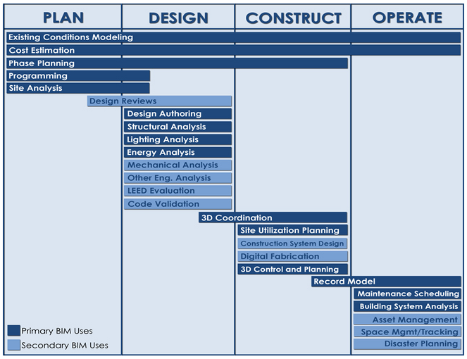
Twin Rivers Elementary/
Intermediate School
McKeesport, PA
CHERRY Q. LU | CONSTRUCTION OPTION
Analysis IV: BIM Implementation
PRESENTATION OUTLINE:
Project Introduction
Analysis 1: LEED Implementation
Problem Identification
Case Studies
Results
Analysis 2: Value Engineering
Problem Identification
Case Studies
Results: Cost Analysis
Electrical Breadth
Structural Breadth
Analysis 3: Schedule Acceleration
Problem Identifications
Results
Analysis 4: BIM Implementation
Problem Identification
Case Studies
Results
Conclusion
Acknowledgements
Appendices
Goal of Analysis IV
Project Features
IPD Project per contract
Minimal integration effort in practice until severe weather impact
Lack of initial collaboration between trades
Multiple design changes and change of orders for value engineering and other purposes
Hearings and decision approval process from the District
Multiple LEED Systems
Potential benefit to operation and maintenance from BIM
Improve construction schedule
Minimize unexpected impact (weather)
Improve project delivery efficiency
The Pennsylvania State University BIM Execution Planning Guide

Slide 23
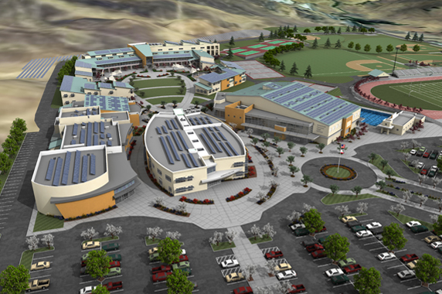
Twin Rivers Elementary/
Intermediate School
McKeesport, PA
CHERRY Q. LU | CONSTRUCTION OPTION
Analysis IV: BIM Implementation
PRESENTATION OUTLINE:
Project Introduction
Analysis 1: LEED Implementation
Problem Identification
Case Studies
Results
Analysis 2: Value Engineering
Problem Identification
Case Studies
Results: Cost Analysis
Electrical Breadth
Structural Breadth
Analysis 3: Schedule Acceleration
Problem Identifications
Results
Analysis 4: BIM Implementation
Problem Identification
Case Studies
Results
Conclusion
Acknowledgements
Appendices
Case Study I:
American Canyon High School
Uniqueness:
Project value of $ 160 million
7 two-stories buildings
260,000 square feet
Similarities:
LEED Certified Public Middle School
Geothermal HVAC system
Hearing and decision process
Renewable energy (solar)
Fast-tracked (2 year of construction time)
Lessons Learned:
BIM was used for conceptual design; clash detection and building performance testing.
BIM also used for daylighting design.
BIM aided in the erection of steel member for the project
American Canyon High School, CA

Slide 24
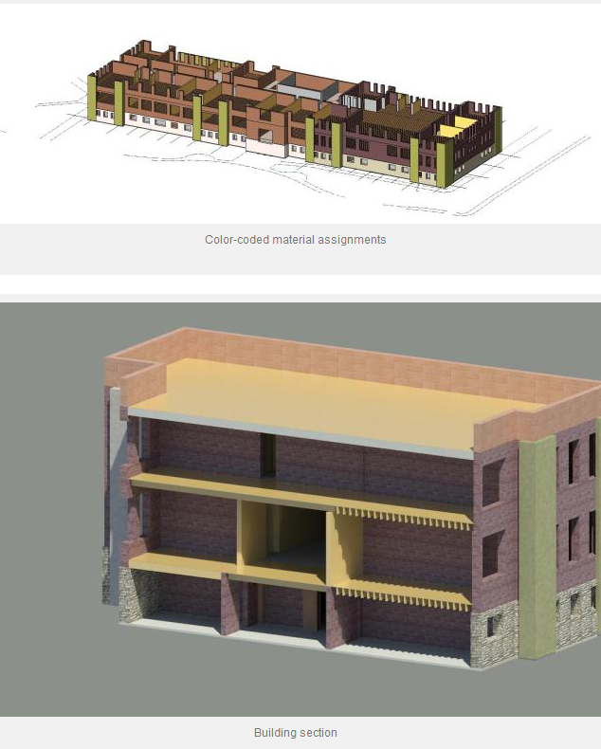
Twin Rivers Elementary/
Intermediate School
McKeesport, PA
CHERRY Q. LU | CONSTRUCTION OPTION
Analysis IV: BIM Implementation
PRESENTATION OUTLINE:
Project Introduction
Analysis 1: LEED Implementation
Problem Identification
Case Studies
Results
Analysis 2: Value Engineering
Problem Identification
Case Studies
Results: Cost Analysis
Electrical Breadth
Structural Breadth
Analysis 3: Schedule Acceleration
Problem Identifications
Results
Analysis 4: BIM Implementation
Problem Identification
Case Studies
Results
Conclusion
Acknowledgements
Appendices
Case Study II:
Whatcom Middle School
Uniqueness:
Complex amalgam of the building
Established a LEED study committee
A vehicle for local business and professional leaders to lend their expertise toward school construction.
Similarities:
Re-construction of previously existed school
Symmetry structural
Aggressive schedule
Lessons Learned:
Major use is during the construction phase
Colored-coded material
Improvement of project team coordination to resolve the problem of design updates
WHATCOM MIDDLE SCHOOL, WA

Slide 25
Twin Rivers Elementary/
Intermediate School
McKeesport, PA
CHERRY Q. LU | CONSTRUCTION OPTION
Analysis IV: BIM Implementation
PRESENTATION OUTLINE:
Project Introduction
Analysis 1: LEED Implementation
Problem Identification
Case Studies
Results
Analysis 2: Value Engineering
Problem Identification
Case Studies
Results: Cost Analysis
Electrical Breadth
Structural Breadth
Analysis 3: Schedule Acceleration
Problem Identifications
Results
Analysis 4: BIM Implementation
Problem Identification
Case Studies
Results
Conclusion
Acknowledgements
Appendices
Owner Involvement Breakdown for Project Phases
Phase | Start Date | End Date | Owner Involvement
Project Planning Phase | 3/24/2009 | 12/9/2009 | Y
Schematic Design Phase | 12/9/2009 | 6/1/2010 | Y
Design Development Phase | 3/1/2010 | 9/6/2010 | Y
Construction Documents Phase | 4/23/2010 | 5/5/2011 | Y
Bidding Phase | 5/25/2010 | 8/225/11 | Y
Construction Administration Phase | 7/8/2010 | 3/24/2014 | Y
Construction Phase | 5/3/2012 | 12/13/2013 | Y
Substantial Completion | 12/13/2013 | 12/13/2013 | Y
Project Close-out | 13/13/2013 | 3/24/2014 | Y
BIM Goals
BIM and IPD
Priority (1-5) 1 - Very Important | Goal Description/ Value added objectives | Potential BIM Uses
1 | Accurate 3D Record Model for Project Team | Record Model, 3D Design/MEP Coordination
1 | Increase Effectiveness of Design | Design Authoring, Design Reviews
2 | Increase Field Productivity | Design Reviews, 3D /MEP Coordination
3 | Increase effectiveness of Sustainable Goals | Engineering Analysis, LEED Evaluation
4 | Lay Out Precautionary Reaction Plan for Unexpected Impacts | Design Reviews, Constructability Analysis
5 | Preparation for Operation and Maintainance | Record Model, Assets Management
 | BIM | IPD
Advantages | Fast-Paced Schedule | Share Critical Information
Disadvantages | Limited Knowledge | Lack of Actual Coordination
Implementation on Twin Rivers | Fast-Paced Schedule Develop O&M Schedule | Enhance Collaboration
Implementation on Public Educational Facility | Meet Different Project Uses | Improve Project Schedule

Slide 26
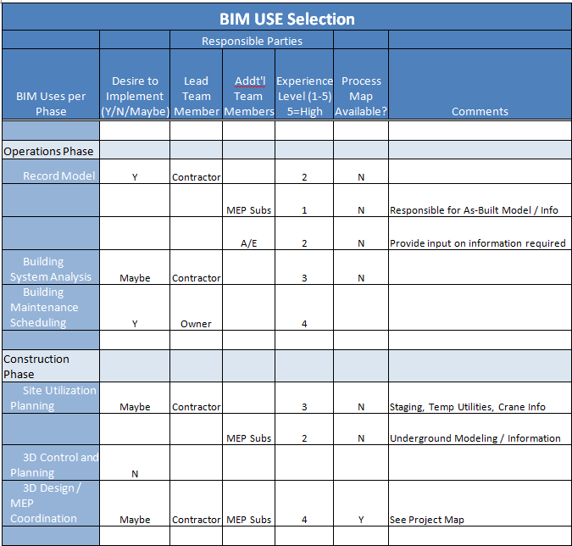
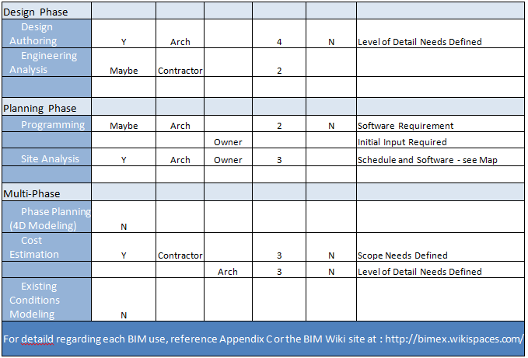
Twin Rivers Elementary/
Intermediate School
McKeesport, PA
CHERRY Q. LU | CONSTRUCTION OPTION
Analysis IV: BIM Implementation
PRESENTATION OUTLINE:
Project Introduction
Analysis 1: LEED Implementation
Problem Identification
Case Studies
Results
Analysis 2: Value Engineering
Problem Identification
Case Studies
Results: Cost Analysis
Electrical Breadth
Structural Breadth
Analysis 3: Schedule Acceleration
Problem Identifications
Results
Analysis 4: BIM Implementation
Problem Identification
Case Studies
Results
Conclusion
Acknowledgements
Appendices
A BIM plan tailed to the construction of Twin Rivers School shows benefits to both the construction, planning and the operation phase.
BIM implementation is highly recommended.

Slide 27
Twin Rivers Elementary/
Intermediate School
McKeesport, PA
CHERRY Q. LU | CONSTRUCTION OPTION
Acknowledgement
PRESENTATION OUTLINE:
Project Introduction
Analysis 1: LEED Implementation
Problem Identification
Case Studies
Results
Analysis 2: Value Engineering
Problem Identification
Case Studies
Results: Cost Analysis
Electrical Breadth
Structural Breadth
Analysis 3: Schedule Acceleration
Problem Identifications
Results
Analysis 4: BIM Implementation
Problem Identification
Case Studies
Results
Conclusion
Acknowledgements
Appendices
Academic:
Penn State Architectural Engineering Faculty
Dr. Ray Sowers
Dr. Robert Leicht
Dr. Craig Dubler
Industrials:
JC Pierce LLC
PJ Dick INC
Loftus Engineers INC
Gurtner Construction LLC
Special Thanks:
David Nitchkey
Ryan Mangan
The Twin Rivers Elementary/Intermediate School Project Team
PACE Industry Members
My Family and Friends
Thank you!

Slide 28
Twin Rivers Elementary/
Intermediate School
McKeesport, PA
CHERRY Q. LU | CONSTRUCTION OPTION
References
PRESENTATION OUTLINE:
Project Introduction
Analysis 1: LEED Implementation
Problem Identification
Case Studies
Results
Analysis 2: Value Engineering
Problem Identification
Case Studies
Results: Cost Analysis
Electrical Breadth
Structural Breadth
Analysis 3: Schedule Acceleration
Problem Identifications
Results
Analysis 4: BIM Implementation
Problem Identification
Case Studies
Results
Conclusion
Acknowledgements
Appendices
"BIM: A Better View of Maintenance." Facilitiesnet. N.p., n.d. Web. 16 Dec. 2013.
"Building Information Modeling (BIM) at Whatcom Middle School" Reid Our Blog. N.p., n.d. Web. Jan. 2014.
"Contract DocumentsContract Documents." AIA RSS. N.p., n.d. Web. 13 Dec. 2012.
"Mount Nittany Elementary." / Home Page. N.p., n.d. Web. 12 Mar. 2014.
"NCEF Resource List: Building Information Modeling (BIM) and Educational Facilities." NCEF Resource List: Building Information Modeling (BIM) and Educational Facilities. N.p., n.d. Web. 19 Jan. 2014.
"Program Details." Wind Energy at Penn State: Pennsylvania Wind for Schools. N.p., n.d. Web. 13 Apr. 2014.
"State College Area School District." State College Area School District / Home Page. N.p., n.d. Web. 2 Apr. 2014.
"Wind for Schools Affiliate Projects." Stakeholder Engagement and Outreach:. N.p., n.d. Web. 13 Apr. 2014.
"Wind for Schools Project Gains Traction in Pennsylvania." NREL: Technology Deployment -. N.p., n.d. Web. 9 Mar. 2014.

Slide 29
Twin Rivers Elementary/
Intermediate School
McKeesport, PA
CHERRY Q. LU | CONSTRUCTION OPTION
Appendices
PRESENTATION OUTLINE:
Project Introduction
Analysis 1: LEED Implementation
Problem Identification
Case Studies
Results
Analysis 2: Value Engineering
Problem Identification
Case Studies
Results: Cost Analysis
Electrical Breadth
Structural Breadth
Analysis 3: Schedule Acceleration
Problem Identifications
Results
Analysis 4: BIM Implementation
Problem Identification
Case Studies
Results
Conclusion
Acknowledgements
Appendices
Project Organization Chart
McKeesport Area School District
Owner
JC Pierce
(David Nitchkey)
Architect & Engineer
PJ Dick
(Joe Brennan)
Construction Manager
Phillips & Associates
Civil Engineer
Loftus Engineer
Structural &MEP Engineer
Garvin Boward Beitko (GBB)
Geotechnical Engineer
American Geosciences
Environmental Engineer
Gurtner Construction
General Contractor

Slide 30
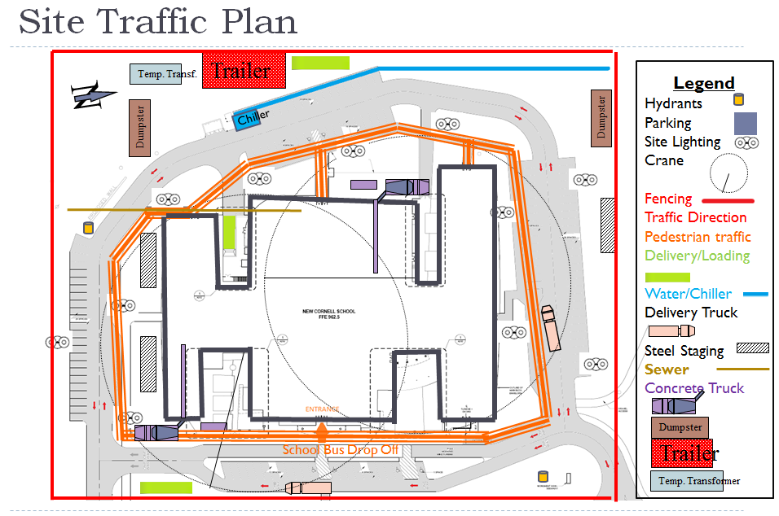
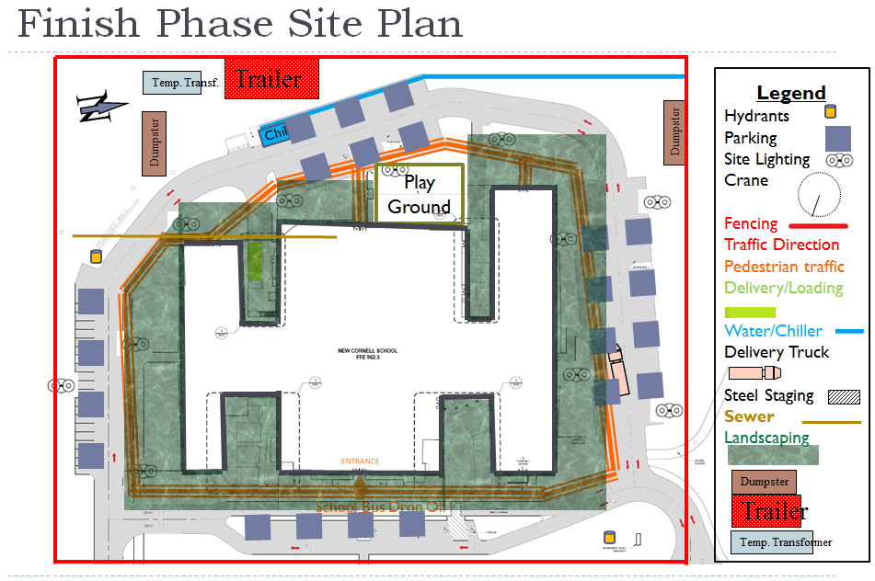
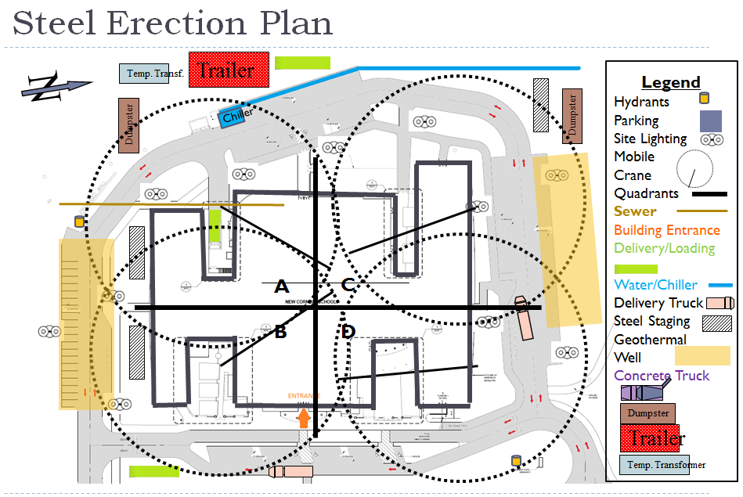
Twin Rivers Elementary/
Intermediate School
McKeesport, PA
CHERRY Q. LU | CONSTRUCTION OPTION
Appendices
PRESENTATION OUTLINE:
Project Introduction
Analysis 1: LEED Implementation
Problem Identification
Case Studies
Results
Analysis 2: Value Engineering
Problem Identification
Case Studies
Results: Cost Analysis
Electrical Breadth
Structural Breadth
Analysis 3: Schedule Acceleration
Problem Identifications
Results
Analysis 4: BIM Implementation
Problem Identification
Case Studies
Results
Conclusion
Acknowledgements
Appendices
Site Logistics and Layout Plan

Slide 31
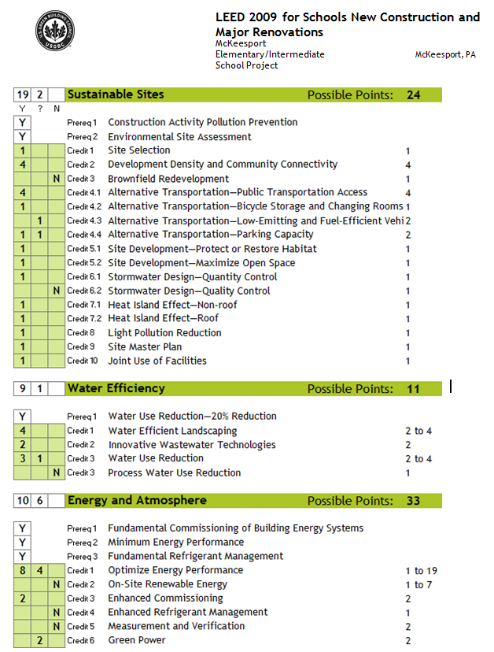
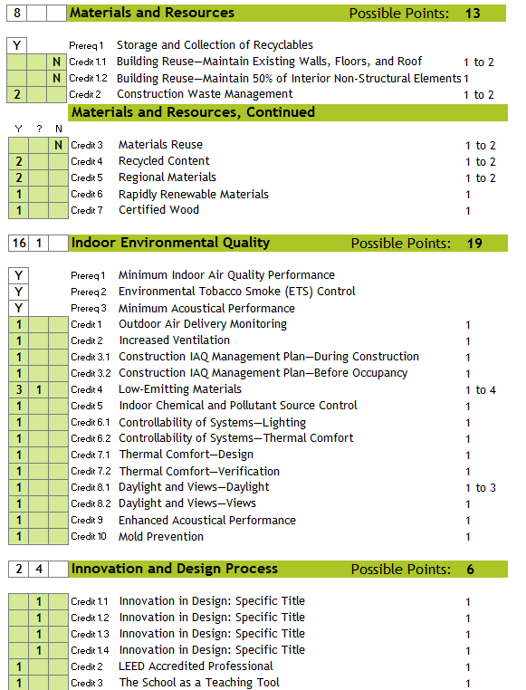
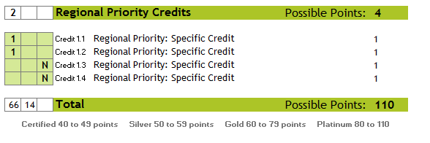
Twin Rivers Elementary/
Intermediate School
McKeesport, PA
CHERRY Q. LU | CONSTRUCTION OPTION
Appendices
PRESENTATION OUTLINE:
Project Introduction
Analysis 1: LEED Implementation
Problem Identification
Case Studies
Results
Analysis 2: Value Engineering
Problem Identification
Case Studies
Results: Cost Analysis
Electrical Breadth
Structural Breadth
Analysis 3: Schedule Acceleration
Problem Identifications
Results
Analysis 4: BIM Implementation
Problem Identification
Case Studies
Results
Conclusion
Acknowledgements
Appendices
LEED Score Cared

